Slide 1
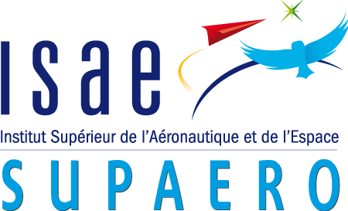
Multifidelity aeroelastic optimization with application to a BWB
S2 progress report
Author: Gilberto ruiz jiménez
Supervisors: Joseph morlier & Joan mas colomer

Slide 2
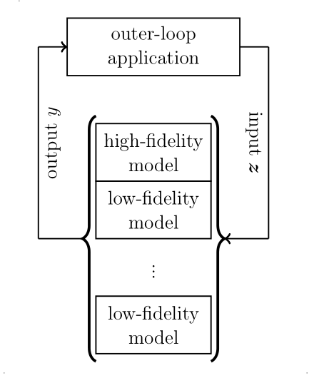
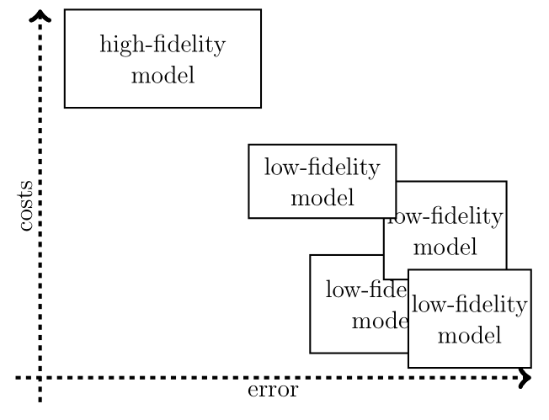
Goal of the Project.
Fluid-Structure Interaction (FSI) is a key feature in aircraft design.
High-Fidelity simulations offer accurate results but are often too expensive for direct design optimizations.
Low-Fidelity analysis offer reasonable approximations with low computational demands.
This project aims to combine low and high-Fidelity analysis to conduct aeroelastic optimization, and apply the method to a BWB configuration.
Figure 1. Multifidelity methods leverage error and costs to speedup simulations. [Peherstorfer et al, 2018]

Slide 3
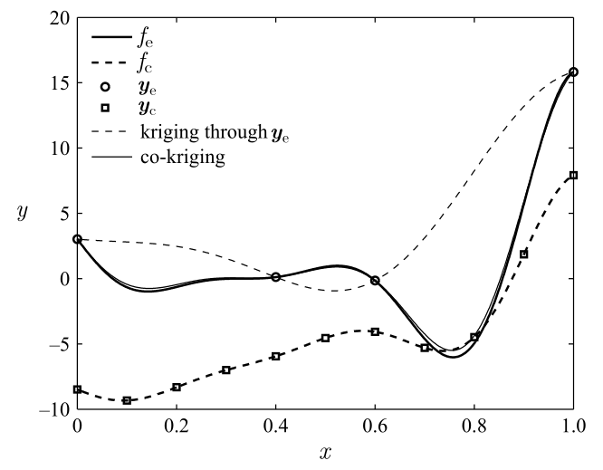
Project Issues
Establish Low and High fidelity models and their isolated implementation.
Define the way the Low-Fidelity model exchanges data with the High-Fidelity one.
Determine the criteria that triggers the alternation from low to high fidelity.
Apply the method to a BWB configuration and validate the results.
Figure 2. Kringing and co-kringing are methods that connect low and high-Fidelity models. [Forrester et al, 2007]

Slide 4
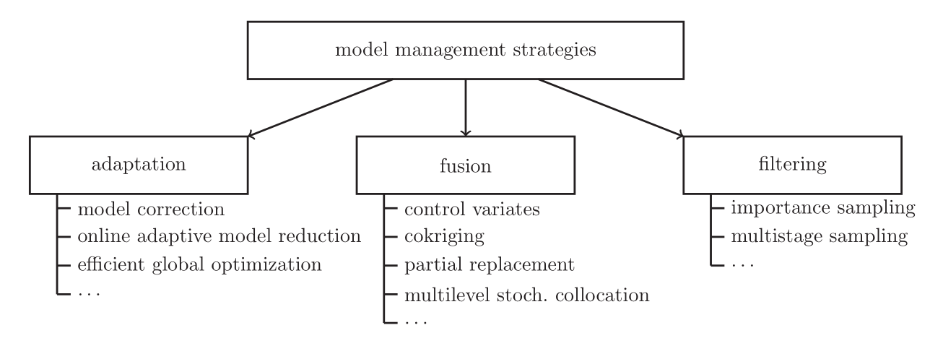
State of the art
[Peherstorfer et al, 2018]

Slide 5
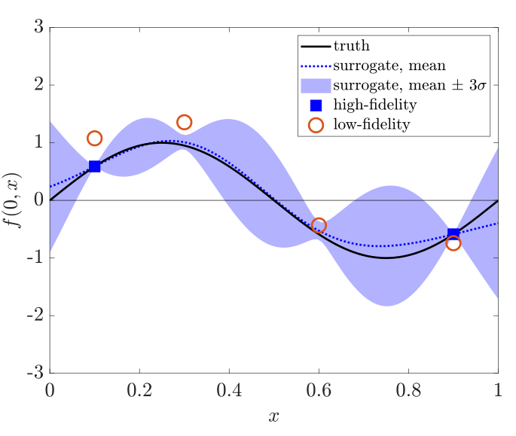
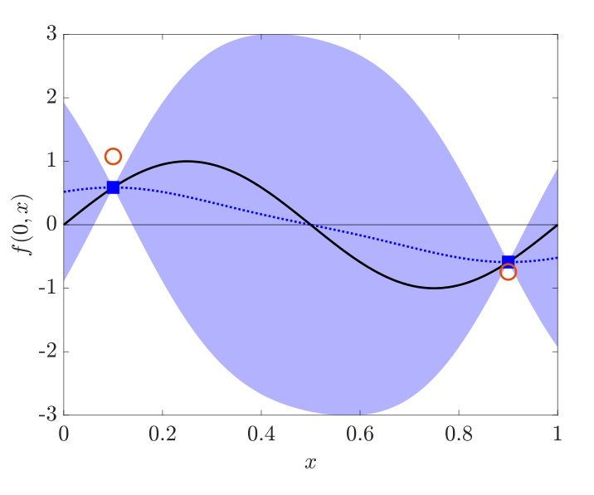
State of the art
Bayesian methods: Commonly used, tested. (TRMM)
Quasi-Newton Inverse Least Squares algorithm (QN-ILS)
ASM-ILS [Scholcz, 2014]
Defect-correction [Jovanov, 2015]
Some other alternatives:
The linear regression approach: balances accuracy, cost and simplicity [Zhang et al, 2018]
Active learning approach: The flutter boundary can be found if treated as a contour location problem [Marques et al, 2019]
Figure 3. Low-Fidelity data improves prediction of High-Fidelity function. [Marques et al, 2019]
Notes:
ASM: Agressive Space Mapping
TRMM: Thrust Region Model Management

Slide 6
Timeline
April
State of the art
Getting acquainted with OpenMDAO
June
S2 Report & Presentation
May
Problem definition
Timeline definition
Algorithm development & programming
Algorithm development & programming
July
Feedback review
Corrections & enhancement

Slide 7
Bibliography
Forrester, A. I., Sóbester, A., & Keane, A. J. (2007). Multi-fidelity optimization via surrogate modelling. Proceedings of the royal society a: mathematical, physical and engineering sciences, 463(2088), 3251-3269.
Jovanov, K., & De Breuker, R. (2015). Accelerated convergence of static aeroelasticity using low-fidelity aerodynamics. In 56th AIAA/ASCE/AHS/ASC Structures, Structural Dynamics, and Materials Conference (p. 0175).
Marques, A. N., Lam, R., Chaudhuri, A., Opgenoord, M. M., & Willcox, K. E. (2019). A multifidelity method for locating aeroelastic flutter boundaries. In AIAA Scitech 2019 Forum (p. 0438).
Peherstorfer, B., Willcox, K., & Gunzburger, M. (2018). Survey of multifidelity methods in uncertainty propagation, inference, and optimization. SIAM Review, 60(3), 550-591.
Scholcz, T. P., van Zuijlen, A. H., & Bijl, H. (2014). Space-mapping in fluid–structure interaction problems. Computer Methods in Applied Mechanics and Engineering, 281, 162-183.
Zhang, Y., Kim, N. H., Park, C., & Haftka, R. T. (2018). Multifidelity Surrogate Based on Single Linear Regression. AIAA Journal, 56(12), 4944-4952.

